Slide 1
Dataset Search Project
Aarti Nimhan - Sagar Sharma - Thao Tran - Christian Dlugosz

Slide 2
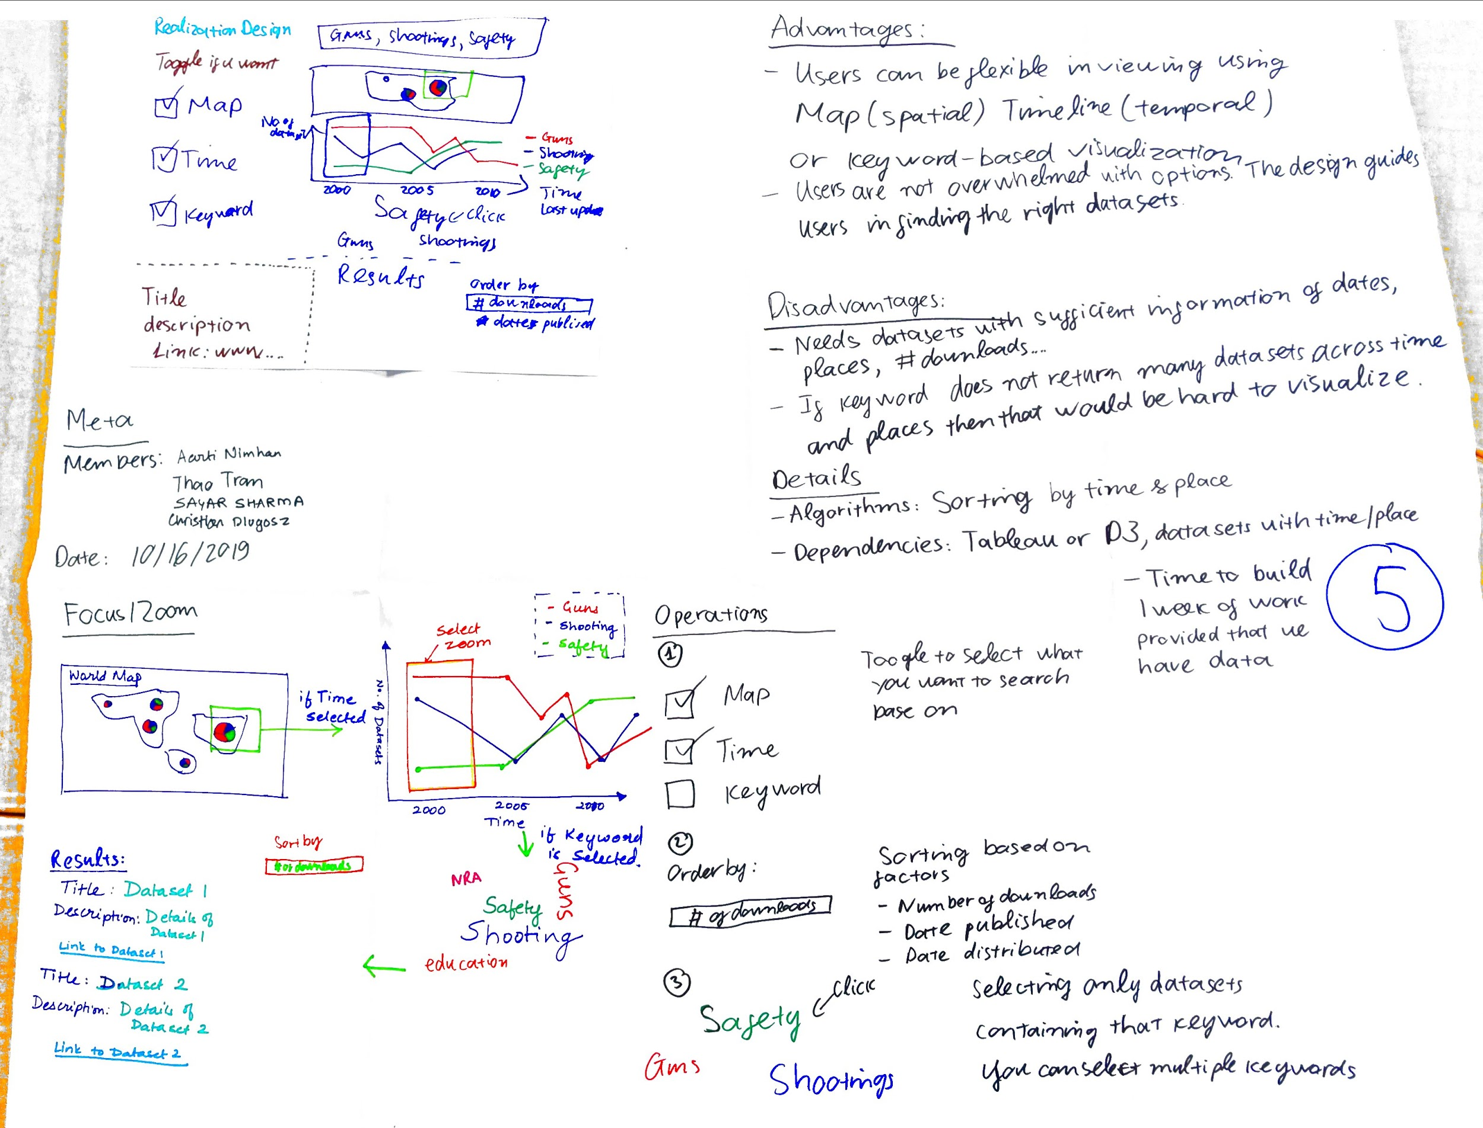
Five Sheet Design
Key Elements
Word Cloud
Geographical Map
Timeline
Search Bar

Slide 3
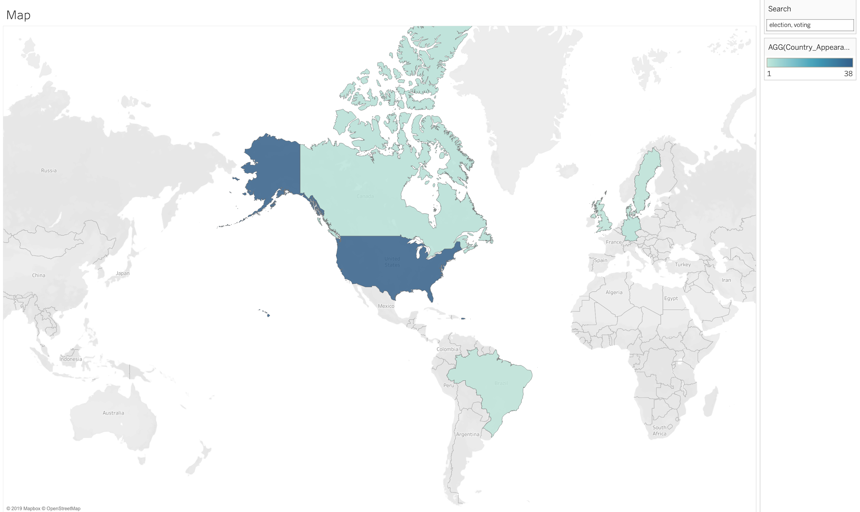
Geographical Map
Key Elements
Zoom and Pan
Color based on number of entries
Dynamically changes based on what subject it is being searched for

Slide 4
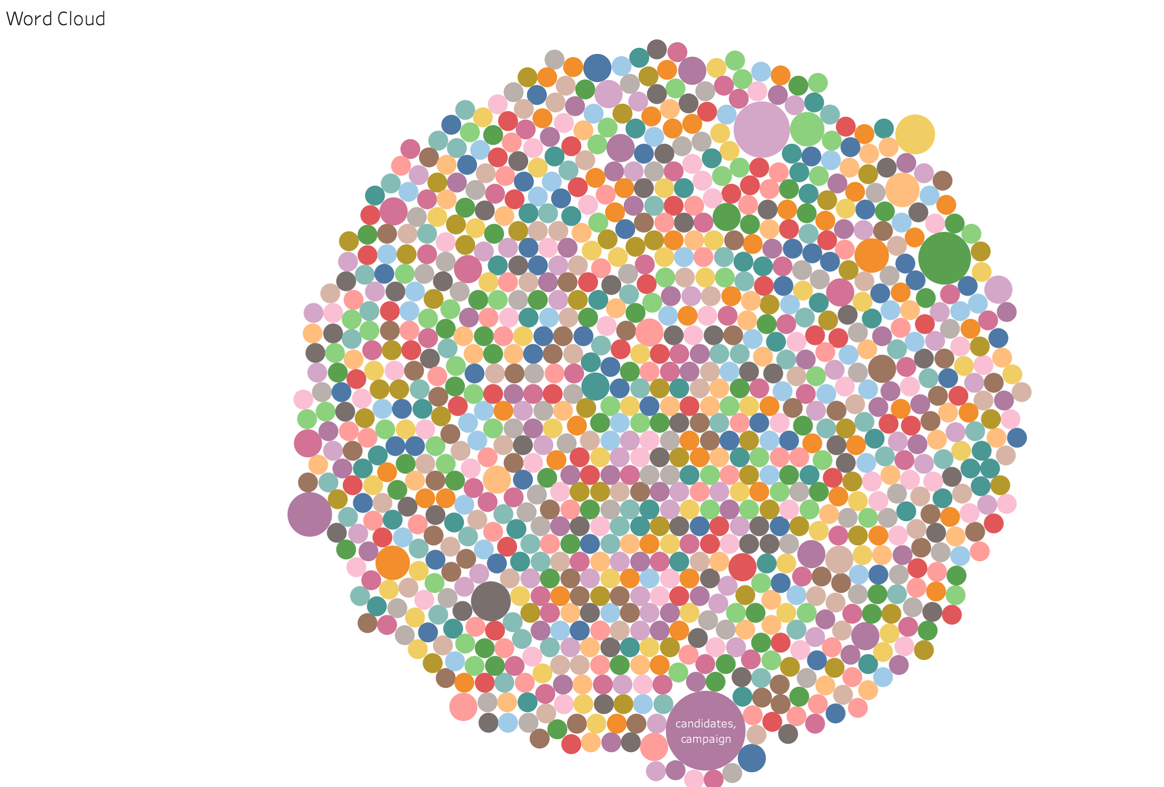
Word Cloud
Key Elements
Size based on number of entries
Dynamically changes based on selected criteria

Slide 5
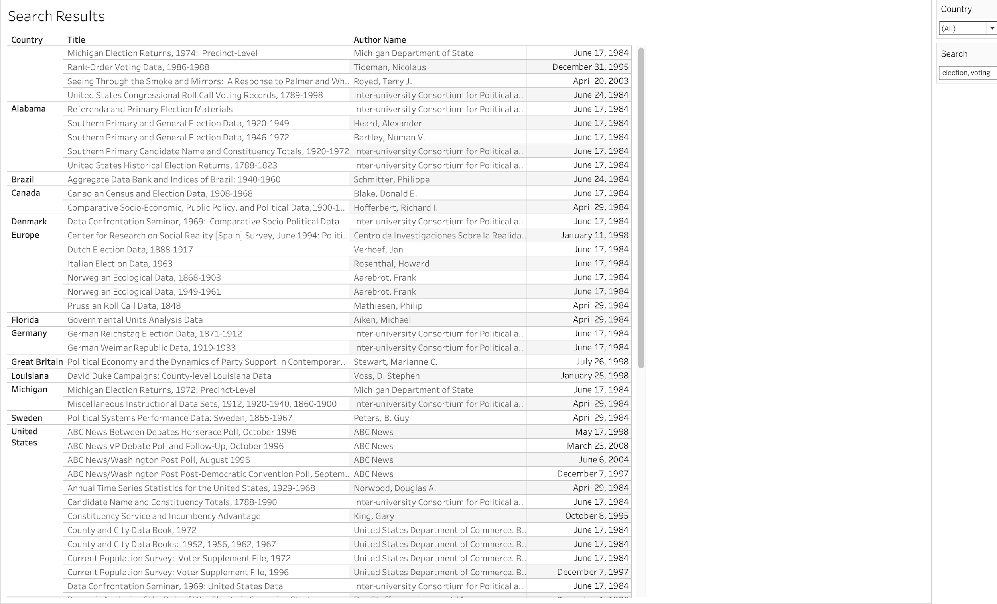
Search Results
Key Elements
Searches grouped by Country and State
Sorted by date-of-entry

Slide 6
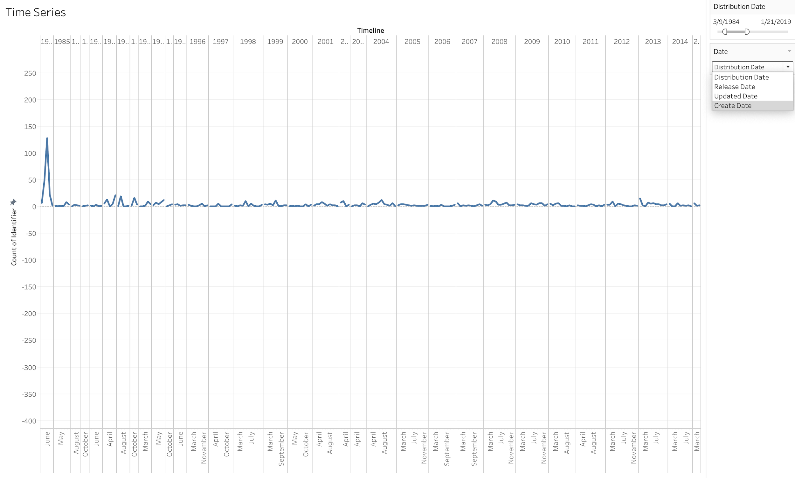
Timeline
Key Elements
Zoom and pan through timeline
Dynamically changes based on selected criteria

Slide 7
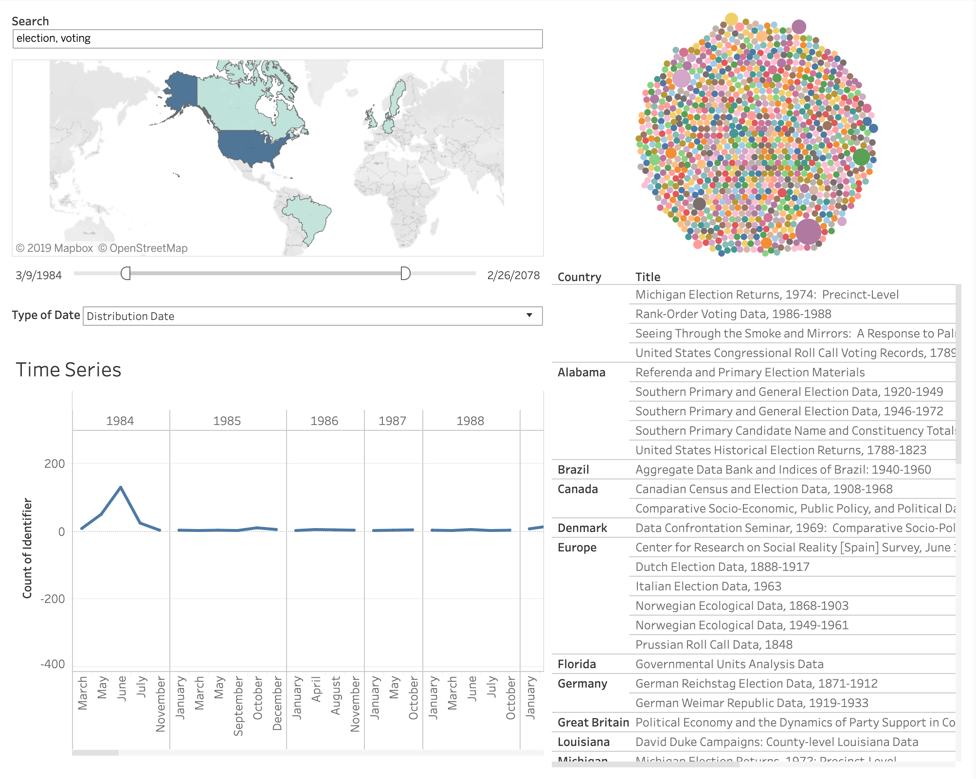
Dashboard
Key Elements
Ability to filter by Map, Time, Keyword, etc.
Ability to order by the # of downloads
Dynamically changes based on what is selected
Dashboard

